Slide 1
Drugs & Magic Remedies Act (OA), 1954 & Rules, 1955

Slide 2
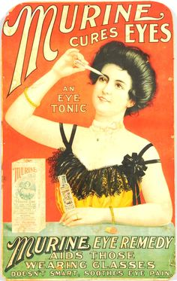
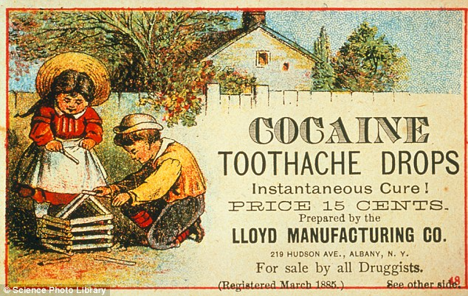
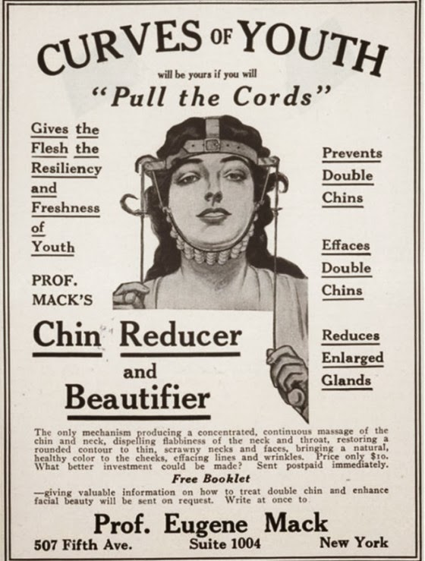

Slide 3
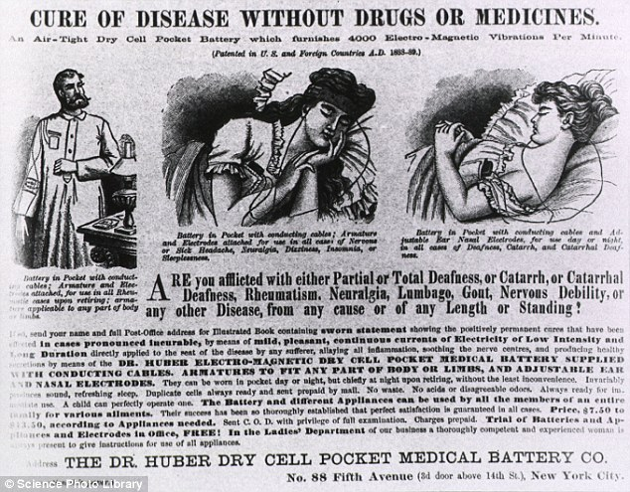
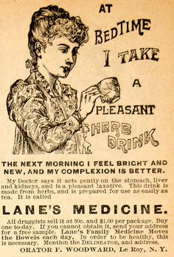

Slide 4
Objective/Legislative Intention
Control certain types of advertisements relating to drugs
Prohibit certain kinds of advertisements related to magic remedies
To provide for matters related therewith

Slide 5
Definitions
1. Advertisement:
Any notice, circular wrapper, label or other documents, and any announcement made orally or by means of producing or transmitting light, sound or smoke
3. Drug
4. Registered Medical Practitioner

Slide 6
2. Magic Remedy:
Includes a talisman, mantra, kavacha and any other charm which is alleged to possess miraculous powers for or in the diagnosis, cure, mitigation, treatment or influencing in any way the structure or any organic function of the body of human beings or animals.

Slide 7
Drug:Includes
(a) medicines for internal or external use of human beings or animals;
(b) any substance intended to be used for or in the diagnosis, cure, mitigation, treatment or prevention of disease in human beings or animals
(c)any article, other than food, intended to affect or influence in any way the structure or any organic function of the body of human beings
(d) any article, intended for use as a component of any medicine, substance or article referred to above

Slide 8
Classes of Prohibited Advertisements
Advertisements related to drugs for-
Miscarriage in women, prevention of conception
Sexual capacity- maintenance or improvement
Menstrual disorders in women
Any other disease specified in the Schedule to the Act

Slide 9
Classes of Prohibited Advertisements
Advertisement containing any matter which gives-
False impression regarding true character of the drug
False claim for the drug
False or misleading in any material

Slide 10
Classes of Prohibited Advertisements
Advertisements of magic remedies for treatment of certain diseases and disorders
Import and export of any document of advertisements referred to in the above clauses

Slide 11
Exemptions or Savings(Classes of exempted advertisements)
Published by Government or with prior permission from Government
Sent confidentially to RMP
Book or treatise dealing with diseases or disorders published with scientific or social point of view
Signboards of RMPs

Slide 12
Exemptions (Classes of exempted advertisements)
Advertisements related to drugs-
Leaflet or literature accompanying drugs
In medicinal, pharmaceutical, scientific journals

Slide 13
Exemptions (Classes of exempted advertisements)
Therapeutic index or list published by license holders
Medical literature distributed by MRs
Containing following information only
Therapeutic indications
Route of administration
Dosage and side effects
Precaution to be taken

Slide 14
Schedule to the Act- List of diseases/disorders/conditions
Offences and Penalties

Slide 15
Case Study
“New Life, New Vigour, New Spirit, New Wave. If you want a cure, see today well known world-famous experienced registered Physician. Special diseases such as oldness in youth, all sorts of defects in nerves, or weakness laziness are treated with full responsibility, with new methods, new machines of science and electric treatment and are cured permanently.. "

Slide 16
Case study
Advt for chloroquine for fever printed on post cards and inland letters challenged in the court
Discussion on TV on Astrology, Spiritual Powers and Supernatural powers in treatment of ailments such as cancer

